Slide 1
Machine Learning with Adversaries
Joseph E. Gonzalez
Co-director of the RISE Lab jegonzal@cs.berkeley.edu

Slide 2
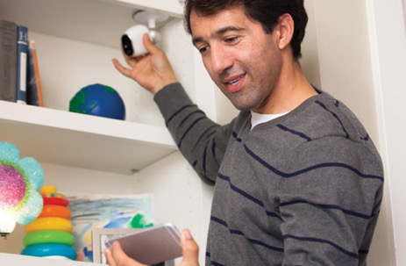
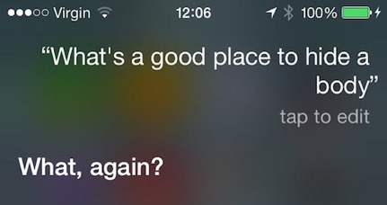
Intelligence in Sensitive Contexts
AR/VR Systems
Home Monitoring
Voice Technologies
Medical Imaging
Protect the data, the model, and the query

Slide 3
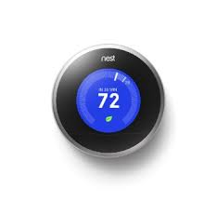
Protect the data, the model, and the query
High-Value Data is Sensitive
Medical Info.
Home video
Finance
Models capture value in data
Core Asset
Sensitive
Data
Queries can be as sensitive as the data

Slide 4






Who/What do you trust?

Slide 5
Attack Scenarios

Slide 6
Training: Data Poisoning Attack
Scenario: Spammers rating emails to affect classifier.
Real-world problem
Kinds of Attacks
Train model to misclassify their spam as ham.
Train model to misclassify everything (DoS attack). why?
Train model to classify competitor email as spam.
Responses
Careful validation of training data
Reject on negative impact (RONI) defense
Personalization
Notes:
RONI Defense B. Nelson, M. Barreno, F. J. Chi, A. D. Joseph, B. I. P. Rubinstein, U. Saini, C. Sutton, J. D. Tygar, and K. Xia. Misleading learners: Co-opting your spam filter. In J. J. P. Tsai and P. S. Yu, editors, Machine Learning in Cyber Trust: Security, Privacy, Reliability, pages 17–51. Springer, 2009.
Collaborative email-spam filtering with the hashing-trick (2009)
http://citeseerx.ist.psu.edu/viewdoc/summary?doi=10.1.1.401.7187

Slide 7
Training: Extracting Model, Alg., Data
Kinds of attacks:
Crafting labeled inputs to reveal important features
Modifying data/gradient to probe global loss
Tracking changes in model to learn about users
Possible Solutions (Federated setting)
Secure multi-party computation
Trusted enclaves

Slide 8
Inference: Evasion Attacks & Adversarial Inputs
Scenarios
spammers modify content to bypass filters
adversary modifies signs to confuse autonomous vehicles
Kinds of Attacks
Leveraging adversarial noise to minimally perturb inputs while substantially changing predictions.
Whitebox attacks seem to transfer to blackbox settings
Possible Solutions
Robust model design
Noise elimination
Arms race …

Slide 9
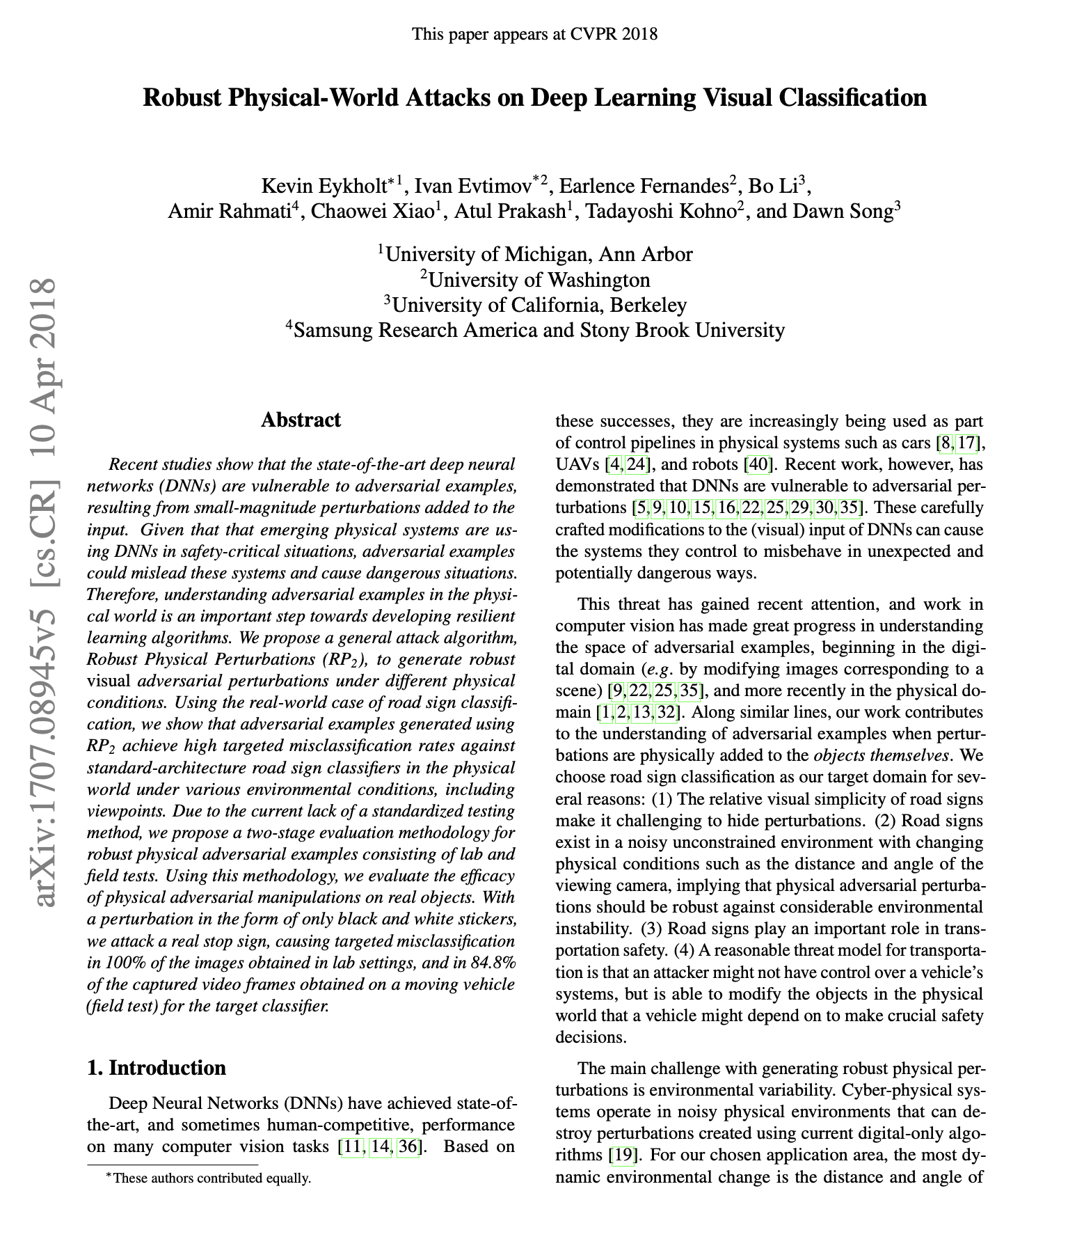
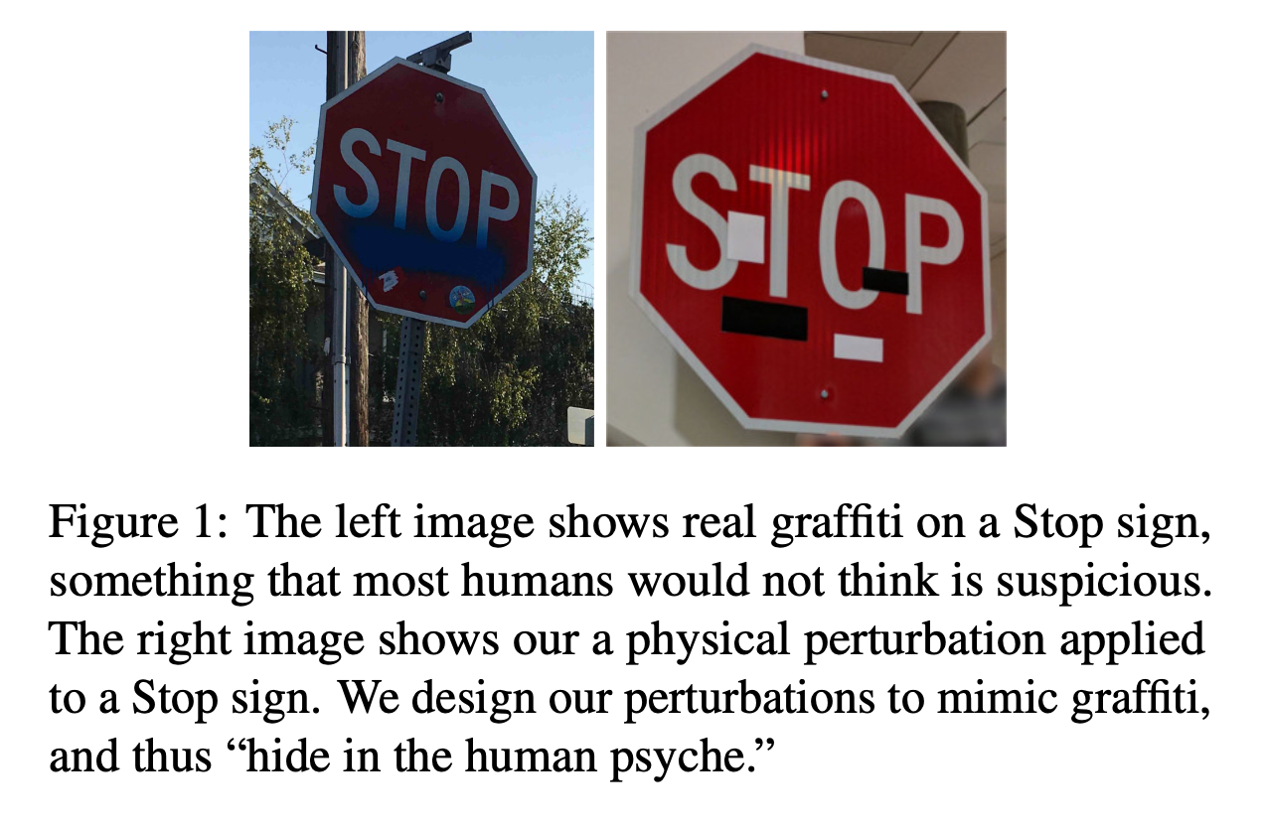
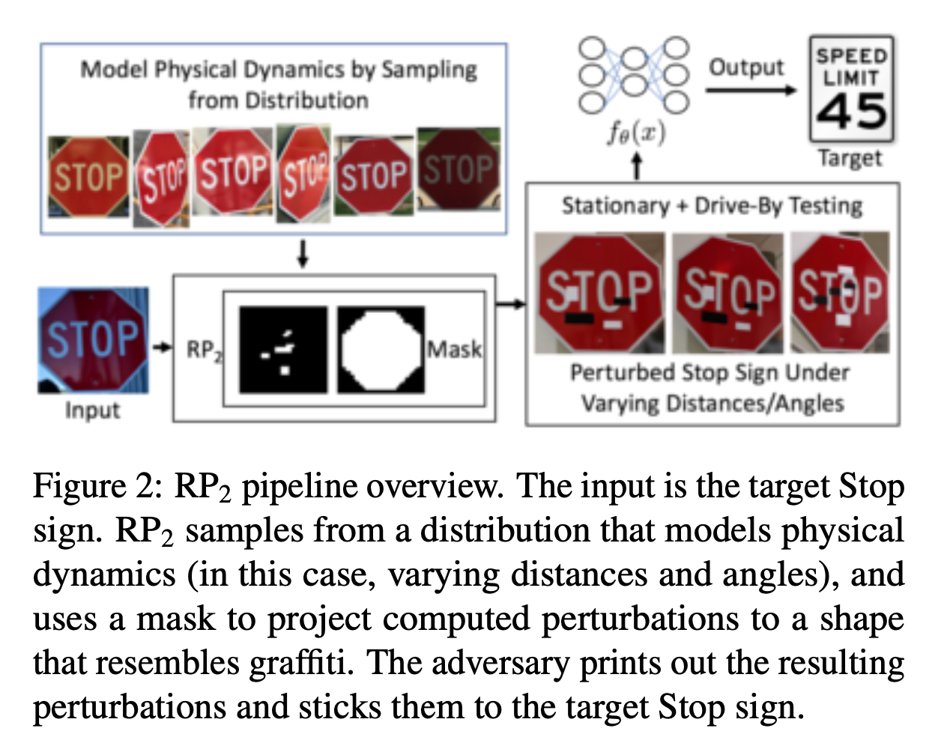

Slide 10
Inference: Model + Data Inversion
Scenario: Query public prediction APIs to extract information from the training data or steal the model.
Kinds of Attacks
Active learning attack to construct training data points that resolve decision boundary and allow model extraction.
Membership inference attacks determine if a piece of data was used in training
Model inversion attacks can construct training inputs given labels
Possible Solutions
Limit confidence information and query rates
Introduce noise in predictions
Model watermarks

Slide 11
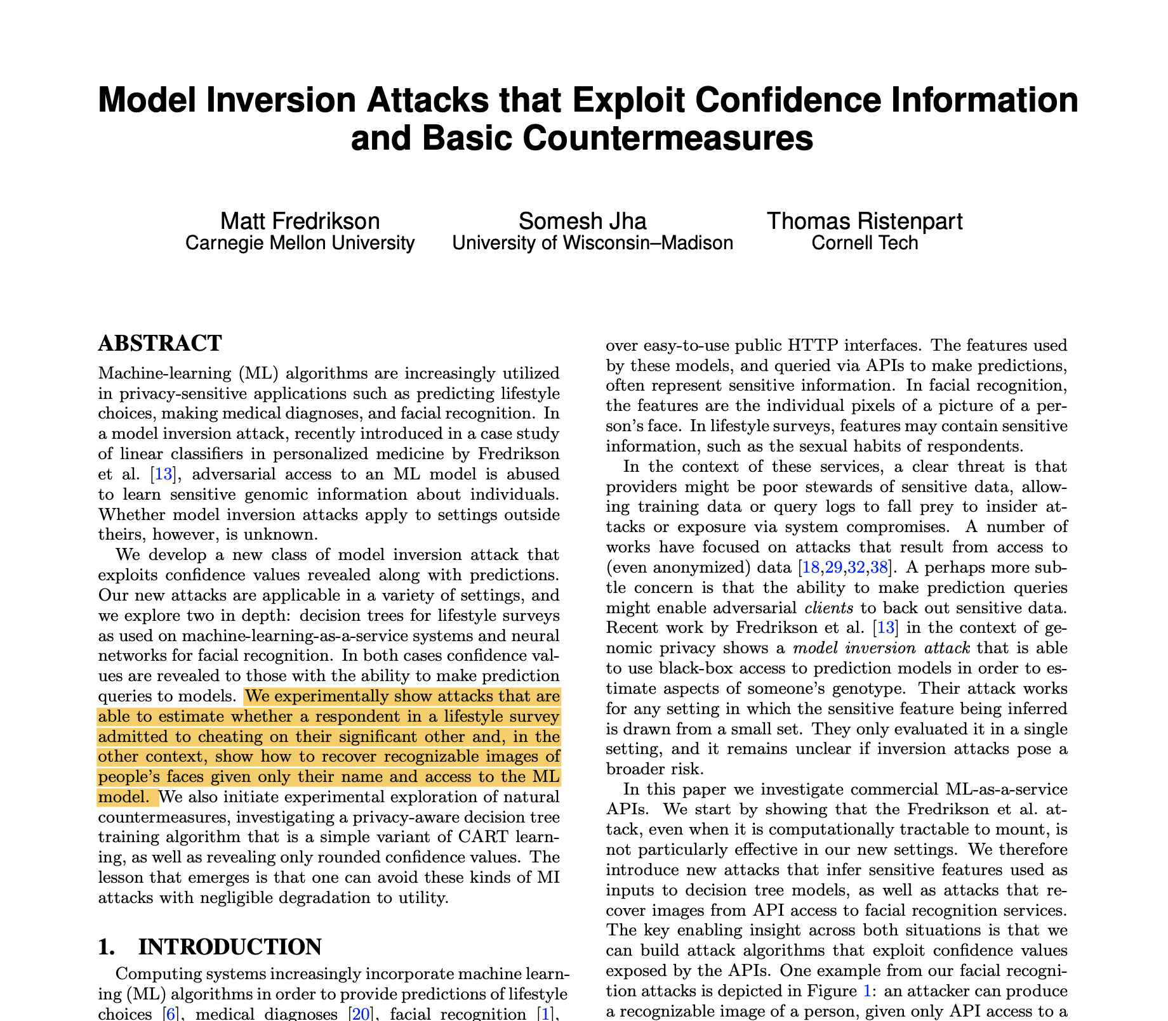
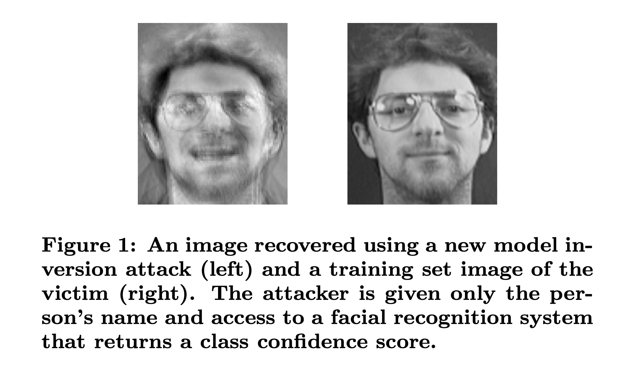

Slide 12
Big Concepts

Slide 13
Big Concepts in Secure ML
Adversarial Inputs: Inputs that are constructed to “trick” classifier into misclassifying (usually for evasion)
Federated Learning: A form of distributed learning in with limited comm. and non-iid data distribution
Differential Privacy: A formal guarantee bounding the information leaked by a randomized algorithm
Security Technologies:
Secure Multi-party Computation: Cryptographic protocols for shared computation without disclosing inputs.
Trusted Execution Environments: Hardware framework for secure computation.

Slide 14


Federated Learning
Terminology was introduced in “Communication-Efficient Learning of Deep Networks from Decentralized Data” (AIStats’17)
A form of distributed learning with:
Original data does not leave device
Limited communication (e.g., WAN)
Data is not assumed to be iid
More parties with far less data each
Infrequent/random participation
Security?

Slide 15
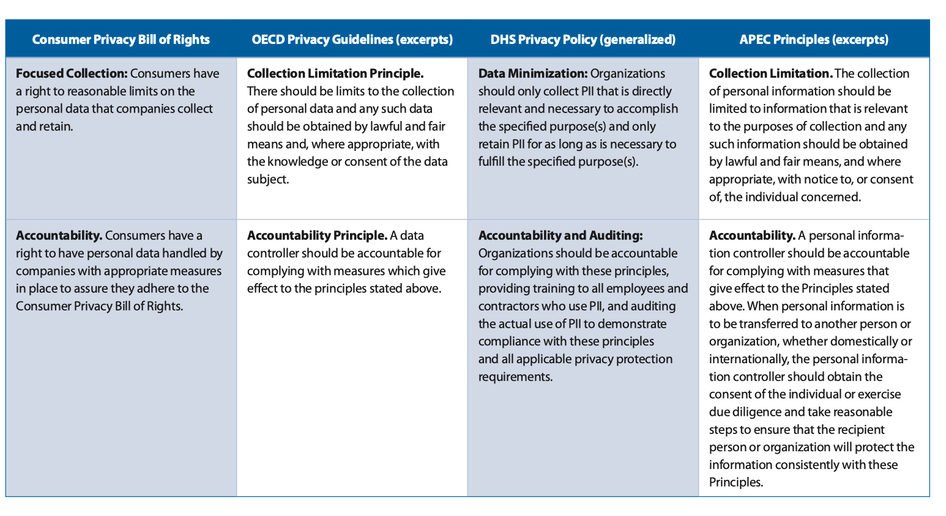
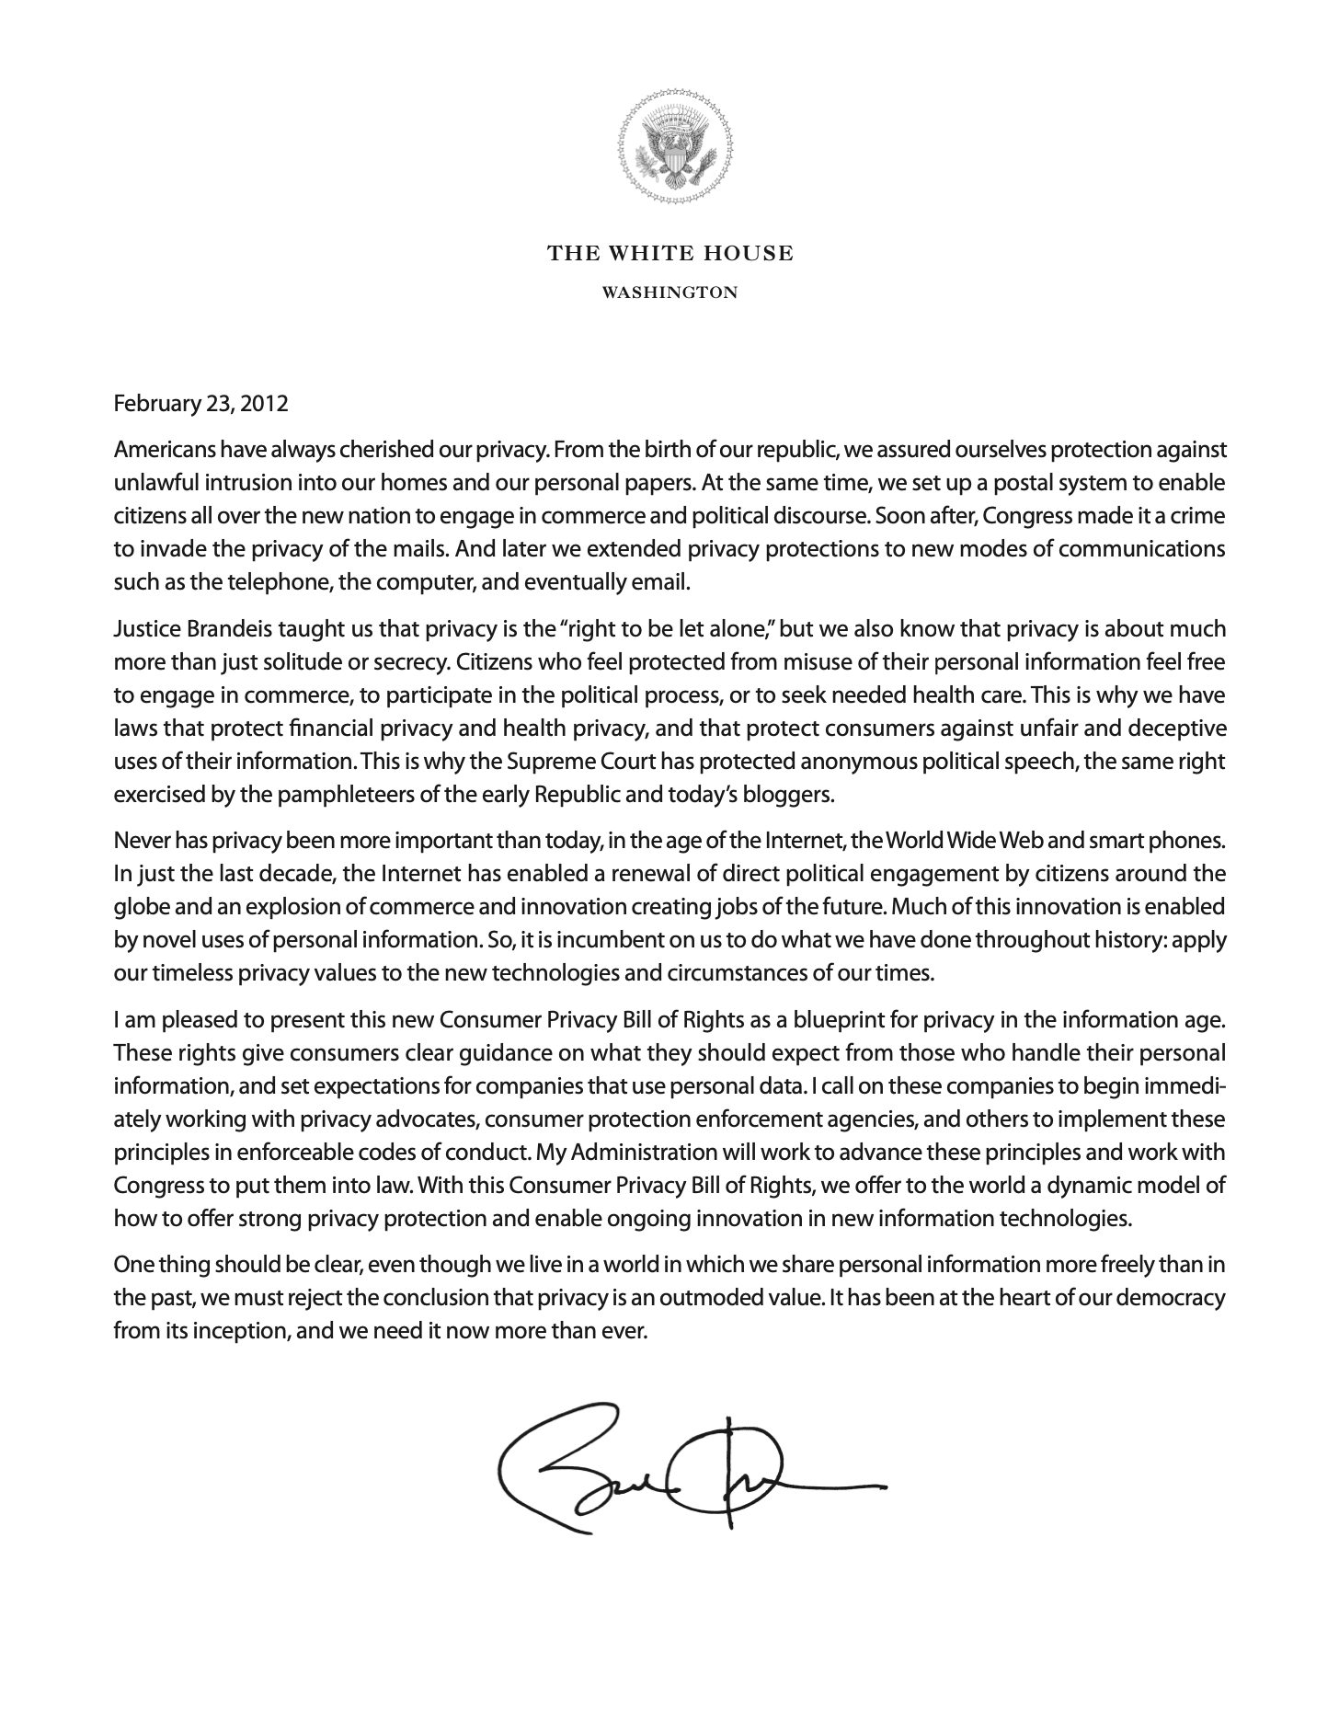
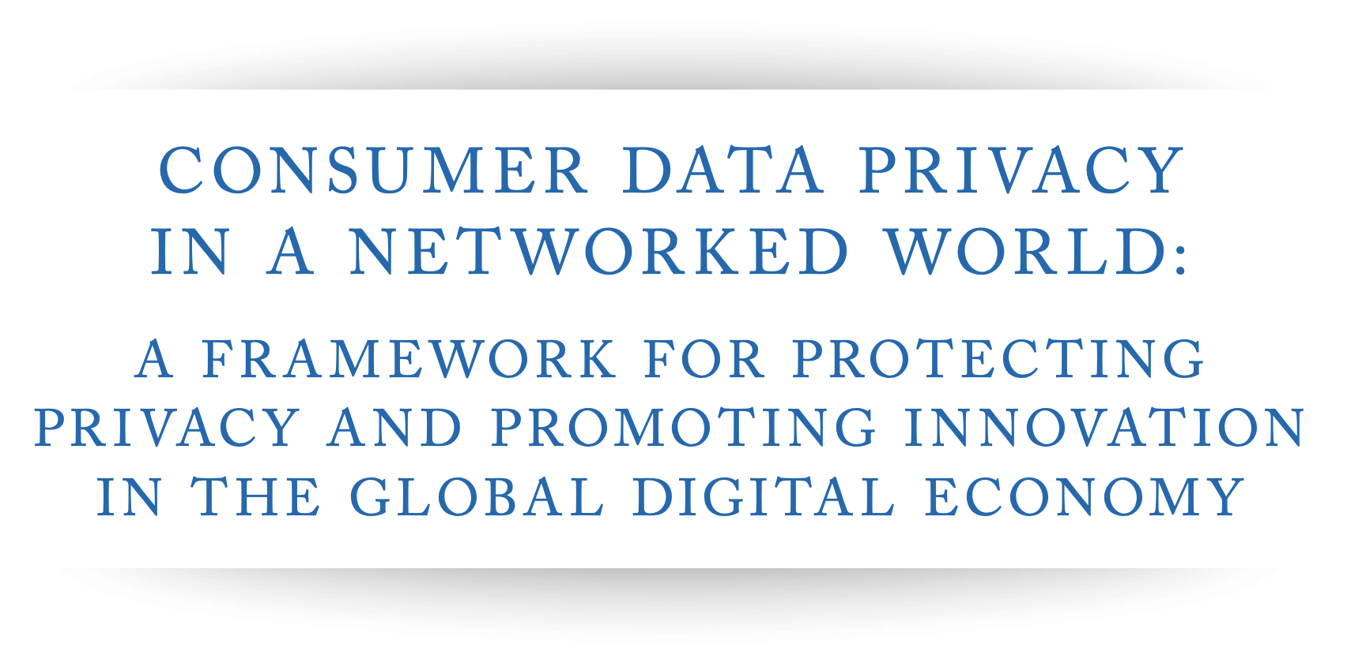
Federated Learning and Security
Eliminates data collection in the cloud
https://obamawhitehouse.archives.gov/sites/default/files/privacy-final.pdf

Slide 16
Federated Learning and Security
Eliminates data collection in the cloud
Helps eliminate risk associated with centralized data
Warrants, rogue employee, curious executives …
“Data is a toxic asset” -- Bruce Schneier
Privacy?
Does not really protect user privacy
Model may still reveal user information
Adversarial users could manipulate protocol to learn about other users
Learning procedure (e.g., FedAvg) leaks raw data
Adversarial cloud/coordinator can extract data
Solutions?
Notes:
Schneier is cryptographer and a fellow at the Berkman Center for Internet & Society at Harvard Law School, and a program fellow at the New America Foundation's Open Technology Institute.

Slide 17

Secure Multi-Party Computation
Family of cryptographic protocols designed to allow multiple parties to compute a function over their inputs while keeping their inputs private

Slide 18



MPC Example: Additive Secret Sharing
Random Numbers
Secret Shares
1
Note that:
Neither person 2 or person 3 knows the value of x₁.
If they collude, they cannot figure out the value of x₁.
2
3

Slide 19
MPC Example: Additive Secret Sharing
Random Numbers
1
2
3

Slide 20
MPC Example: Additive Secret Sharing
Random Numbers
1
Parties all share their partial sums
2
3

Slide 21
MPC Example: Additive Secret Sharing
Random Numbers
1
Rearranging and cancelling out terms:
2
3

Slide 22
Secure Multi-Party Computation
Family of cryptographic protocols designed to allow multiple parties to compute a function over their inputs while keeping the inputs private
More sophisticated protocols
Shamir secret sharing: uses evaluation of random polynomials
Supports addition and multiplication
User specified fault tolerance (not all parties must participate)
Privacy?

Slide 23
MPC Example: Additive Secret Sharing
1
Note that:
Neither person 2 or person 3 knows the value of x₁.
If they collude, they cannot figure out the value of x₁.
2
The computation still reveals information.
In secure MPC we assume that each party is willing to share outcome of computation.
3

Slide 24
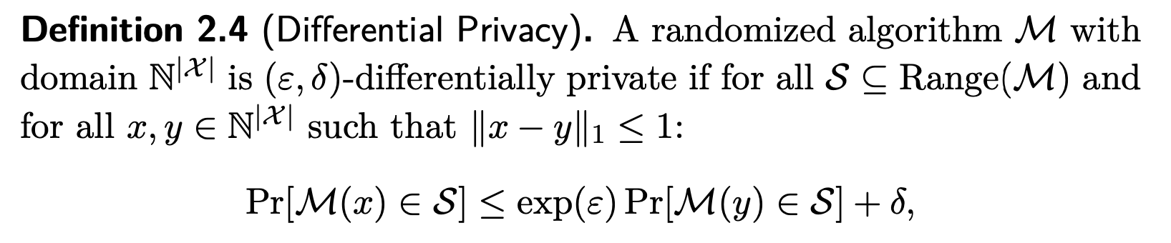
Differential Privacy
Guarantees that only a limited amount of information is leaked about data involved in a computation.
Formalized in 2006 by Dwork, McSherry, Nissim, and Smith
Builds on randomized response (1965)
Have you cheated on an exam?
obs = 0.5 + 0.5 p
p = (obs – 0.5) / 0.5
0.5
Heads → Raise your Hand
Flip Coin
p
Raise your Hand
0.5
Tails → Answer Honestly
Don’t raise your hand
(1-p)
https://www.cis.upenn.edu/~aaroth/Papers/privacybook.pdf

Slide 25
Differential Privacy
Guarantees that only a limited amount of information is leaked about data involved in a computation.
Formalized in 2006 by Dwork, McSherry, Nissim, and Smith
Builds on randomized response (1965)
Have you cheated on an exam?
obs = 0.5 + 0.5 p
p = (obs – 0.5) / 0.5
0.5
Heads → Raise your Hand
Flip Coin
p
Raise your Hand
0.5
Tails → Answer Honestly
Don’t raise your hand
(1-p)
https://www.cis.upenn.edu/~aaroth/Papers/privacybook.pdf

Slide 26
x
y
https://www.cis.upenn.edu/~aaroth/Papers/privacybook.pdf

Slide 27
Achieving Differential Privacy
Several mechanisms built around the addition of noise
Laplace mechanism is most common/simple

Slide 28
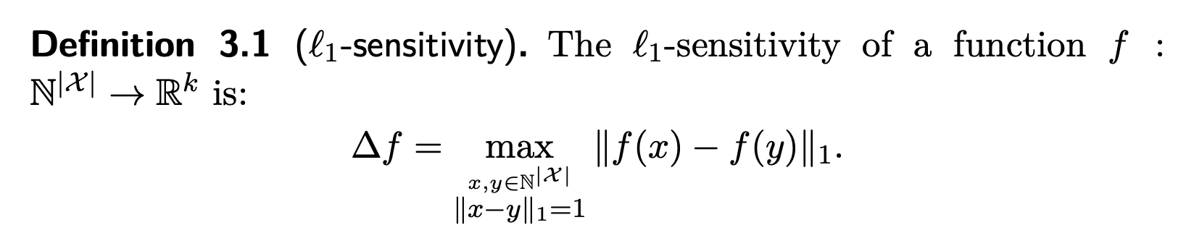
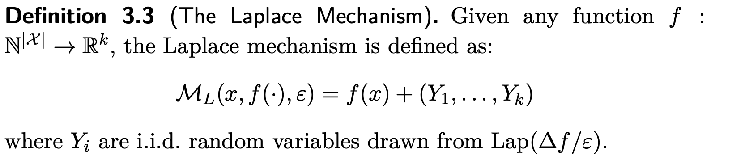
Laplace Mechanism
https://www.cis.upenn.edu/~aaroth/Papers/privacybook.pdf

Slide 29
Laplace Mechanism
https://www.cis.upenn.edu/~aaroth/Papers/privacybook.pdf

Slide 30
Laplace Mechanism
Zero Mean
Samples from Laplace distribution.
Proof
https://www.cis.upenn.edu/~aaroth/Papers/privacybook.pdf

Slide 31
Laplace Mechanism
Zero Mean
Samples from Laplace distribution.
Proof
https://www.cis.upenn.edu/~aaroth/Papers/privacybook.pdf

Slide 32
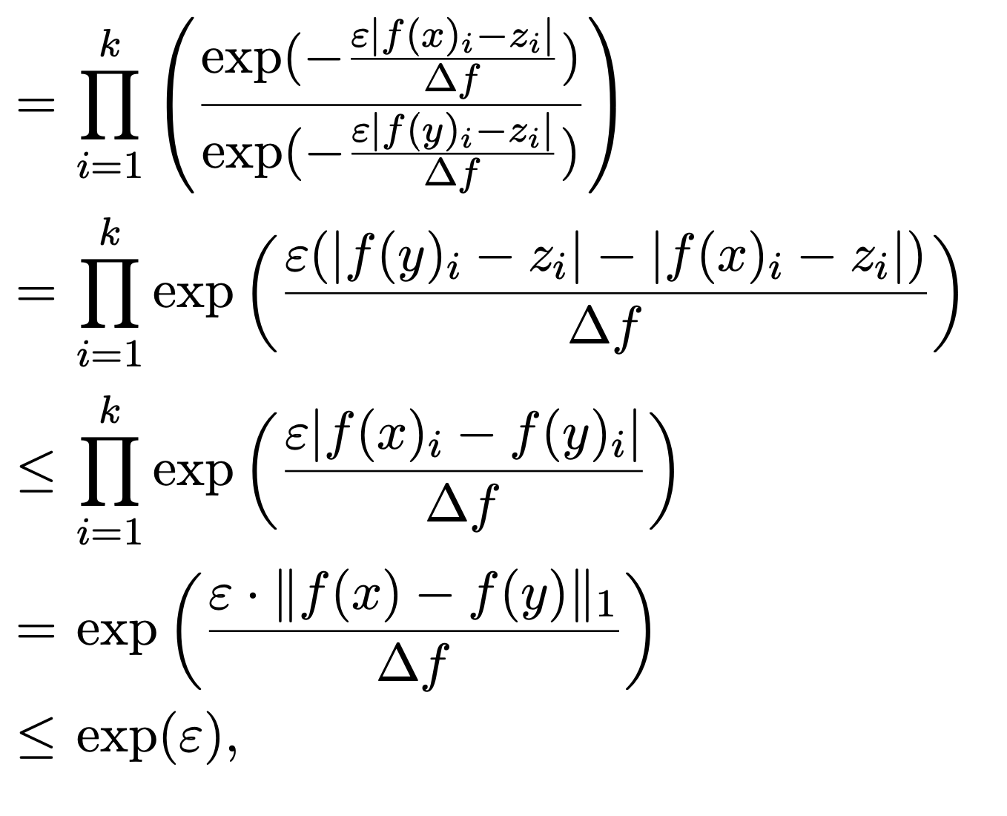
Laplace Mechanism
Zero Mean
Samples from Laplace distribution.
Proof
Product of K iid draws from
A Laplace Distribution
https://www.cis.upenn.edu/~aaroth/Papers/privacybook.pdf

Slide 33
Laplace Mechanism
Zero Mean
Samples from Laplace distribution.
Proof
Product of K iid draws from
A Laplace Distribution
Algebra
https://www.cis.upenn.edu/~aaroth/Papers/privacybook.pdf

Slide 34
Laplace Mechanism
Zero Mean
Samples from Laplace distribution.
Proof
Product of K iid draws from
A Laplace Distribution
Algebra
Triangle Inequality
https://www.cis.upenn.edu/~aaroth/Papers/privacybook.pdf

Slide 35
Laplace Mechanism
Zero Mean
Samples from Laplace distribution.
Proof
Product of K iid draws from
A Laplace Distribution
Algebra
Triangle Inequality
Algebra
https://www.cis.upenn.edu/~aaroth/Papers/privacybook.pdf

Slide 36
Laplace Mechanism
Zero Mean
Samples from Laplace distribution.
Proof
Product of K iid draws from
A Laplace Distribution
Algebra
Triangle Inequality
Algebra
Definition of Sensitivity
https://www.cis.upenn.edu/~aaroth/Papers/privacybook.pdf

Slide 37
Laplace Mechanism
Zero Mean
Samples from Laplace distribution.
Proof
Product of K iid draws from
A Laplace Distribution
Algebra
Triangle Inequality
Algebra
Definition of Sensitivity
https://www.cis.upenn.edu/~aaroth/Papers/privacybook.pdf

Slide 38
Differential Privacy: Issues
Privacy-Utility Tradeoff: What are the right values of (ε,𝛿) to balance privacy and accuracy?
Privacy Budget: each differentially private operation on the data leaks information.
At some point you must stop querying the data

Slide 39
Trusted Execution Environments
Hardware primitives that isolate data and computation from other processes, the OS, and even hardware attacks while attesting to the correct execution.
isolation: typically encrypt data in memory and prevent other processes including the OS from observing computation
attestation: verify the integrity of the computation as well as all inputs.
Examples:
Intel SGX (Software Guard Extensions)
AMD Memory Encryption
ARM TrustZone

Slide 40
Trusted Execution Environments
Advantages
Minimal impact on compute performance.
Support for fully generic computation
Leverage industry standard encryption rather than PHE/FHE
Disadvantages
Need to trust hardware manufacturer
Sign certificates and verify code
Bugs: exploits like Spectre and Meltdown can compromise SGX
Susceptible to a wide range of side channel attacks
Current implementations have some performance limitations
SGX Enclave Page Cache (EPC) is limited to ~100MB → very slow to move data in and out of EPC
Single socket desktop processor

Slide 41
Reading This Week

Slide 42
Reading for the Week
Communication-Efficient Learning of Deep Networks from Decentralized Data (AIStat’17)
Introduced Federated Learning setting and federated averaging
Privacy Accounting and Quality Control in the Sage Differentially Private ML Platform (SOSP’19)
Differential privacy ML platform which doesn’t expire
Slalom: Fast, Verifiable and Private Execution of Neural Networks in Trusted Hardware(ICLR’19)
Combine trusted execution environment (SGX) with untrusted hardware (GPU) for inference
Robust Physical-World Attacks on Deep Learning Models [CVPR’ 18 ]
Highly influential paper on on adversarial attacks on computer vision models

Slide 43
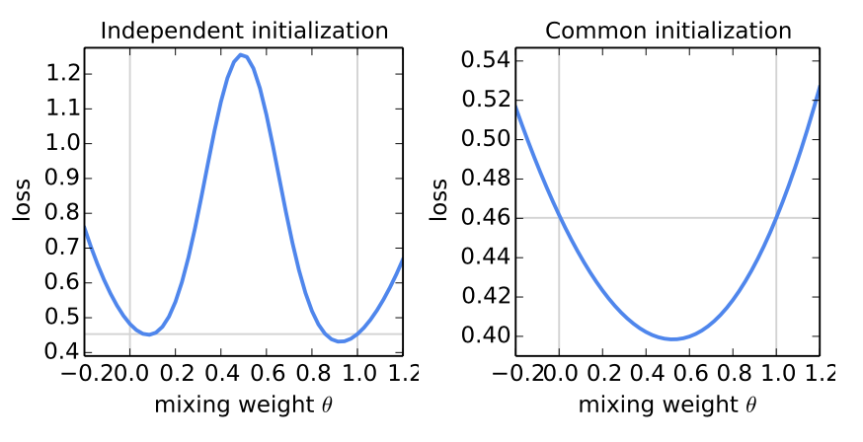
Communication-Efficient Learning of Deep Networks from Decentralized Data (AIStats’17)
Early work framing the federated setting
Identified several key challenges: comm., non-iid, participation
Advocating for distributed model averaging in the federated setting
Counter intuitive (at the time)
Non-iid assumption
Non-convexity of deep learning

Slide 44
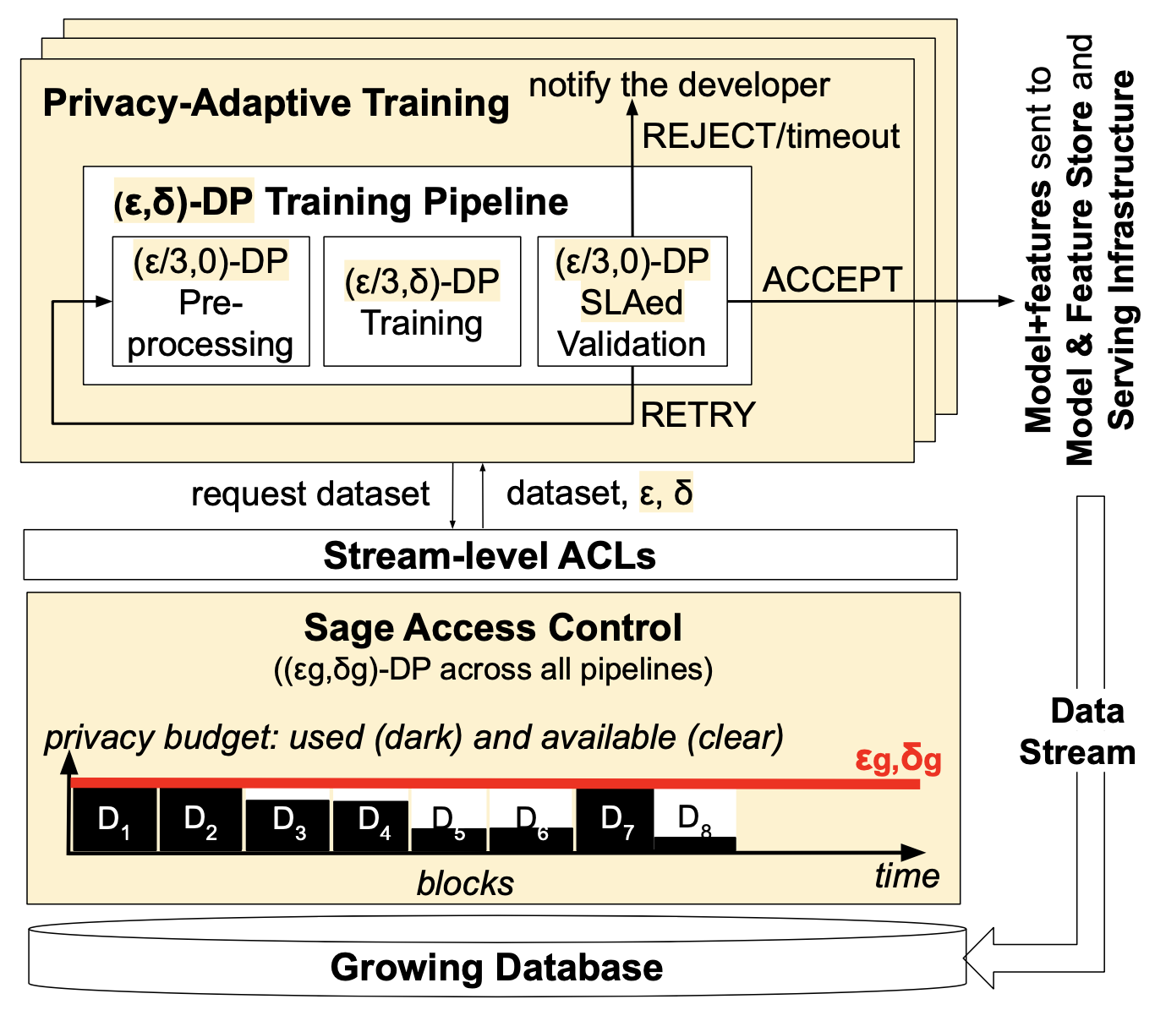
Privacy Accounting and Quality Control in the Sage Differentially Private ML Platform (SOSP’19)
Platform for differential privacy accounting that interposes in existing ML frameworks.
Addresses the problems:
Managing a privacy budget and extending the privacy budget
Balancing privacy and accuracy objectives with retraining
Big Idea: Break data into blocks with independent privacy budgets

Slide 45
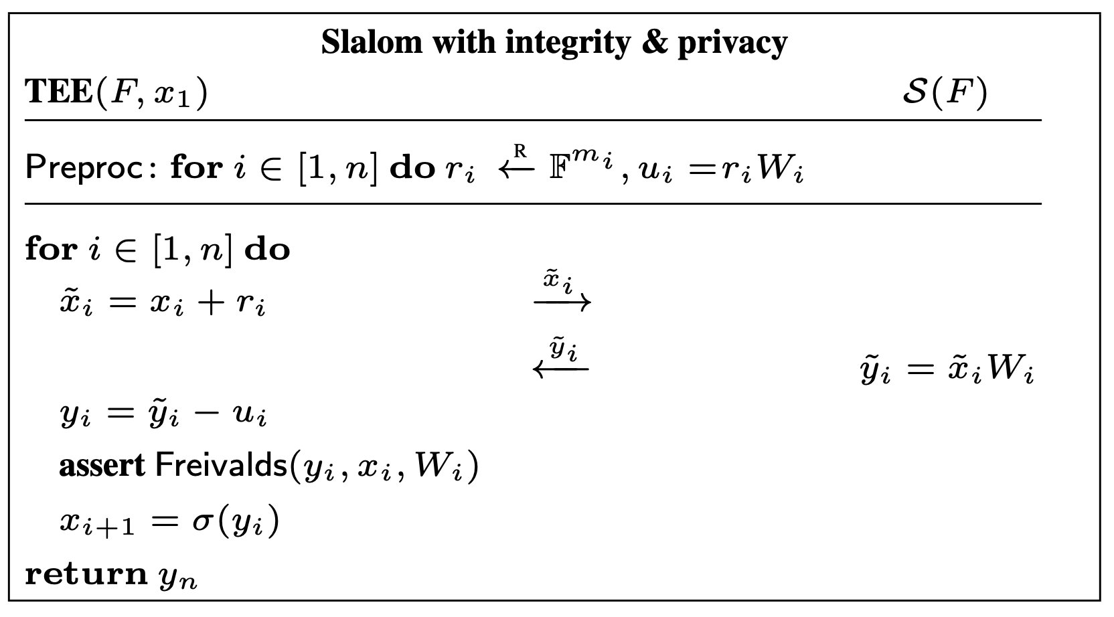
Slalom: Fast, Verifiable and Private Execution of Neural Networks in Trusted Hardware (ICLR’19)
Use cryptographic techniques to combine TEE with untrusted accelerator during inference.
Big Idea: Leverage linearity operators to compute over pre-computed noise

Slide 46
Done!

